Slide 1
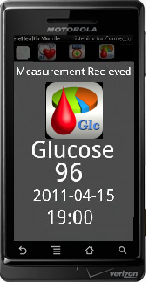
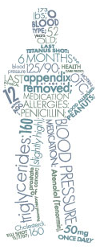
“
“Healthcare Untethered”
“Measurement received your
glucose reading is 96”
“Medición recibido su lectura
de glucosa es de 96”
The Future of Managing Health in the Home and on the Go

Slide 2
Current Medicare Facts
Re-Admitted Patient
17.6% of Medicare beneficiaries are readmitted within 30 days of being discharged from a hospital
CHF Re-Admission Rates
25% of CHF patients are readmitted withing 30 days of being discharged from a hospital
Patient is Monitored and Coached
For those who do receive some form of post-acute care, reported readmission rates have been seen to drop as low as 5.3%
FACT Medicare Beneficiaries
64% of readmits receive no post-acute care between discharge and readmission
Your Logo

Slide 3
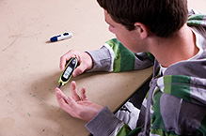
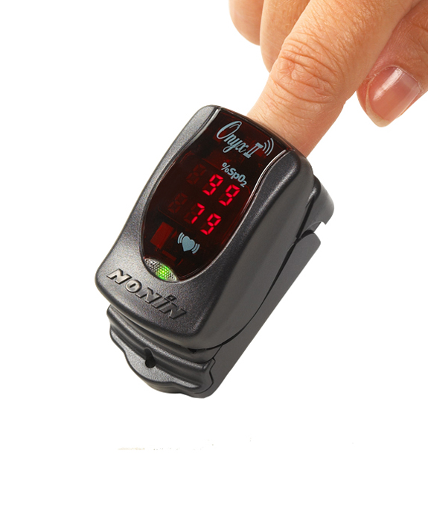
Advantage Home Telehealth (ADHT) brings the exam room to the patient
Work
School
Vacation
Home

Slide 4
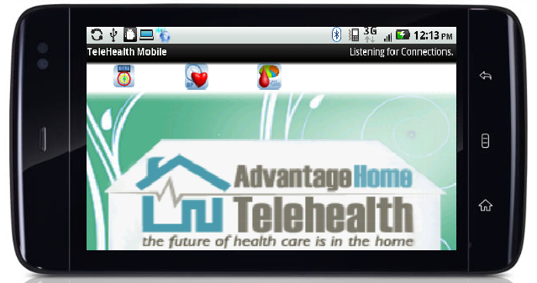
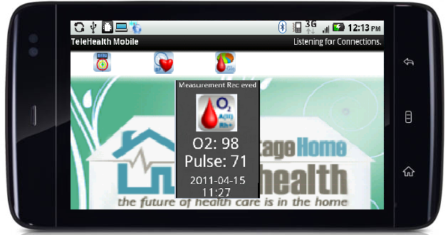
Patient Flow: Patient with Heart Failure
Y
Y
Patient Intake
Telehealth Kit is brought to patient by ADHT
Alert Parameters are set
Vital Signs are taken
Y
Y
“Measurement received
your Pulse is 71
and
Oxygenation is 98”

Slide 5
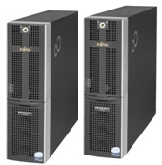
ADHT brings the office to the clinician
Y
Y
Y
Real Time Data
Server
Role-based access to the portal…
…anywhere, anytime
Y
Cautionary & red alert vital sign data
Alerts via SMS
or
Email
Y

Slide 6
ADHT provides the monitoring
Y
Y
Y
Real Time Data
Monitoring based on protocols
Server
Y
Patient/Caregiver is engaged in a discussion:
How are you feeling?
Was medication taken as prescribed
Were vital signs taken properly?
Could you repeat Vital Sign(s)… as per protocols
Adherence to nutritional guidelines and exercise
Improved Outcomes and Compliance:
Cause & effect between vital signs & lifestyle, education
Peace of mind, feeling of being cared for
Data is shared with patient’s healthcare team
Consistent message for improved care
Y
Patient is contacted

Slide 7
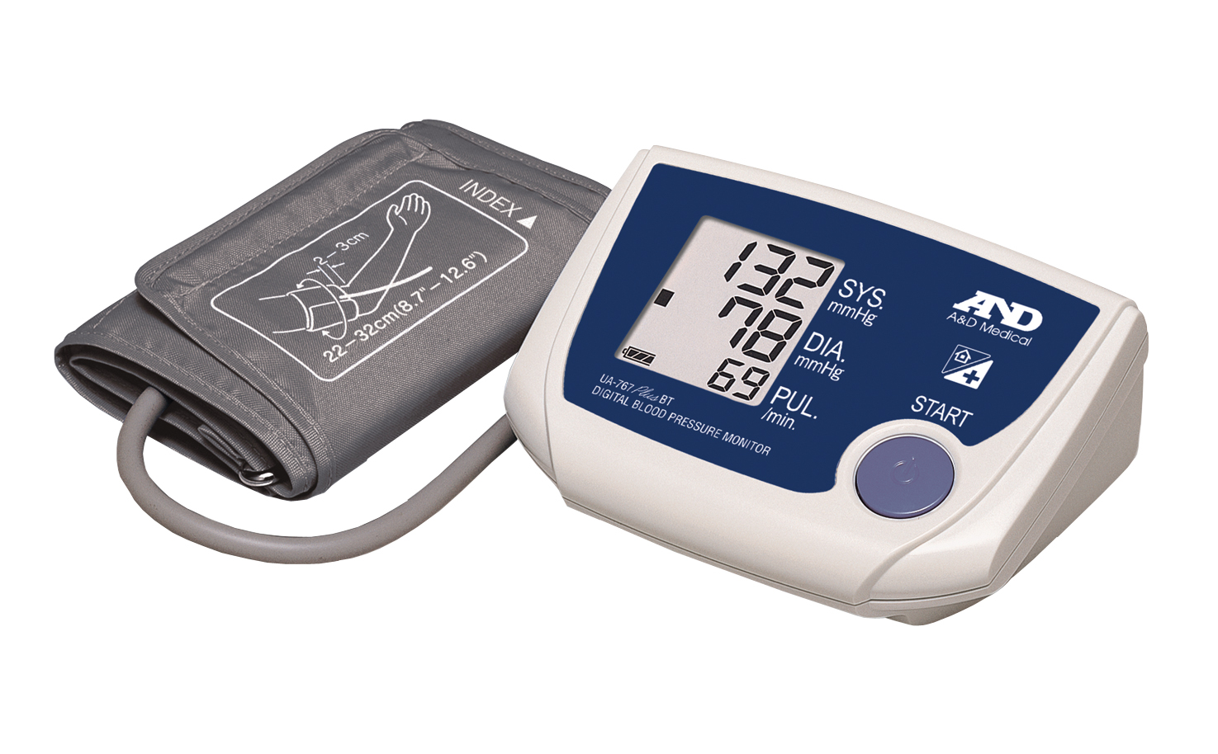
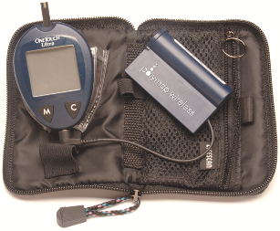
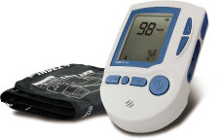
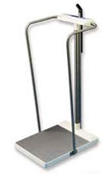
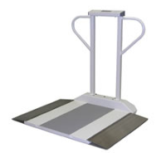
Current Blue Tooth Devices:
New Blue Tooth Devices being added:
Pediatric
Bariatric
Other
Slide 7

Slide 8
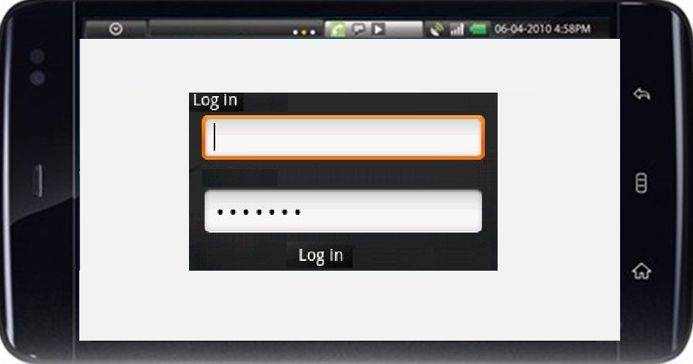
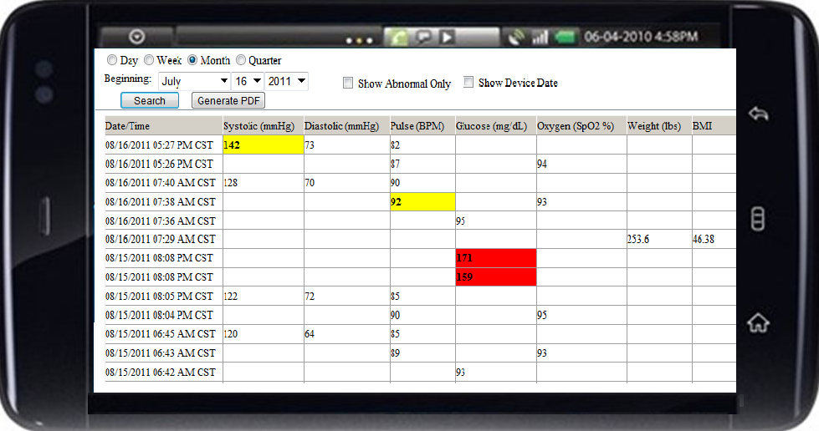
Mobile Kiosk – used by Clinician
Take Vital Signs on the go
Access the portal on the go

Slide 9
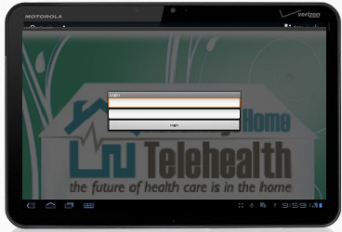
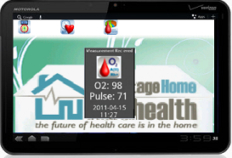
Kiosk – individual/patient
Y
User Name Password
Facial Recognition
Patient Logs In
OR
With Name Confirmation
Vital Signs are taken
Y
Y
“Measurement received
your Pulse is 71
and
Oxygenation is 98”

Slide 10
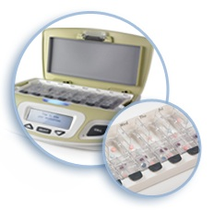
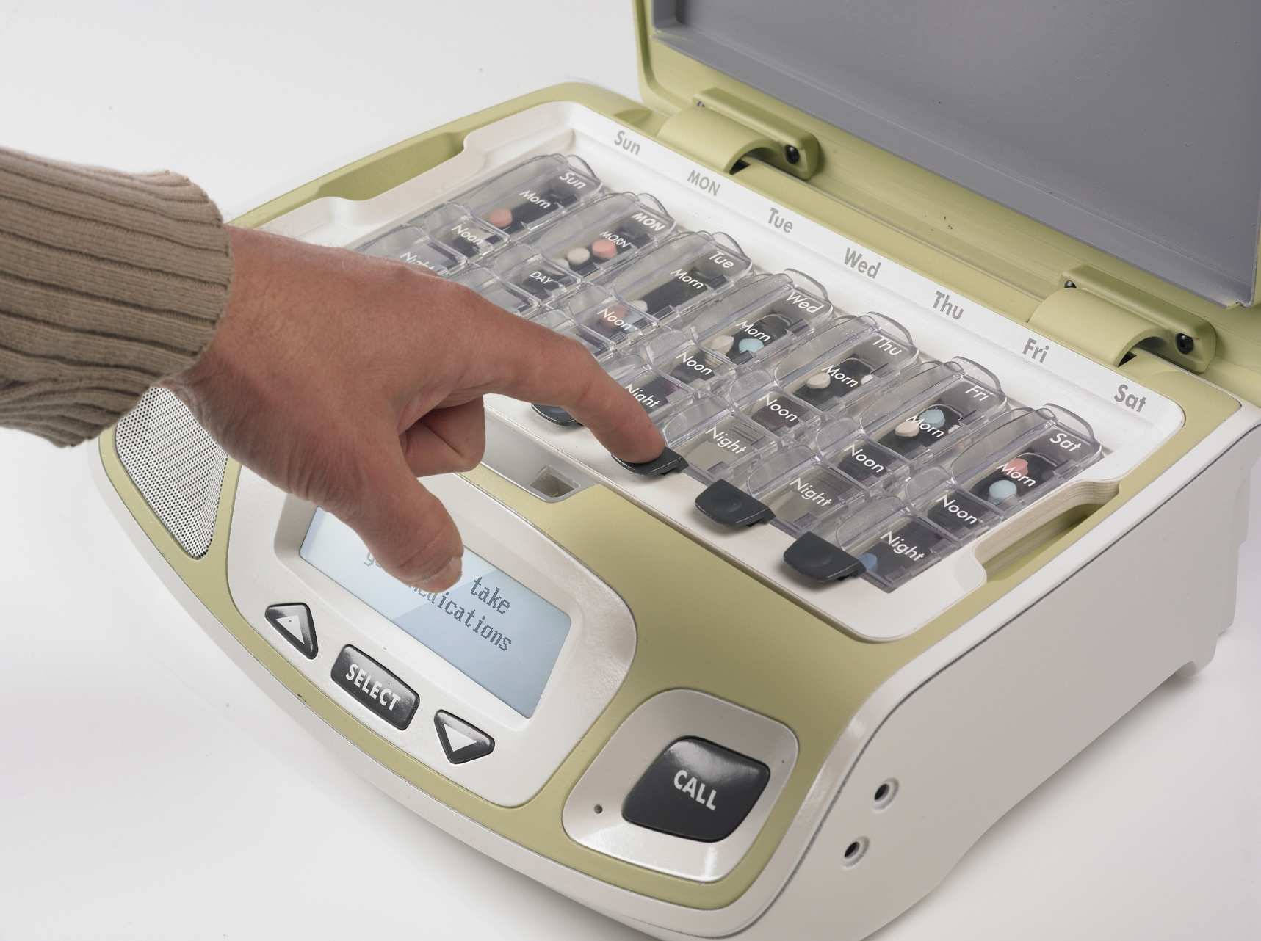
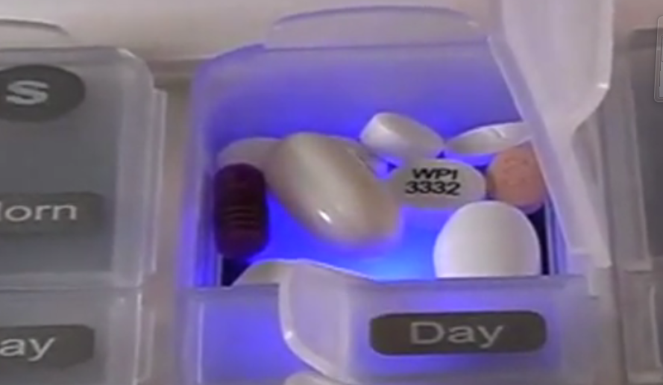
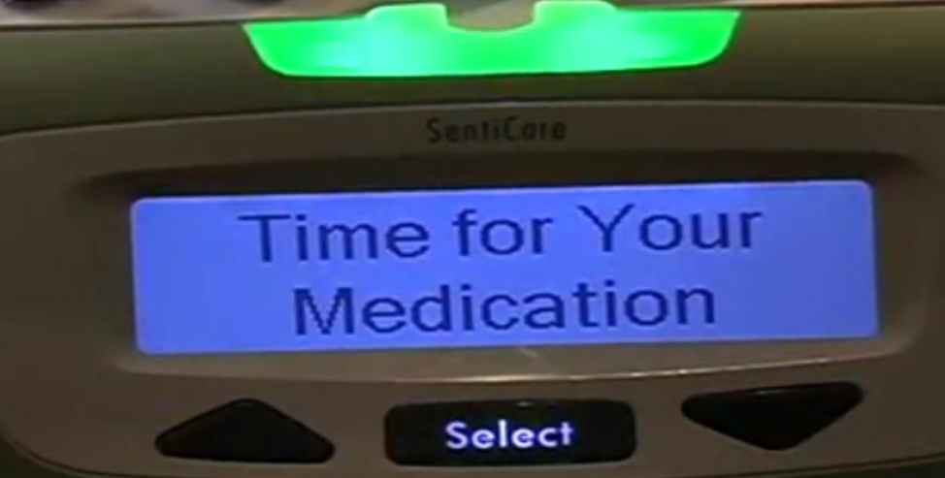
Patient Flow Medication:
Y
Y
Y
Patient Intake
Unit is brought to patient
Pharmacist Delivers Medications
Medication List Faxed
Medication tray is filled
Y
Medication is Taken
Y

Slide 11
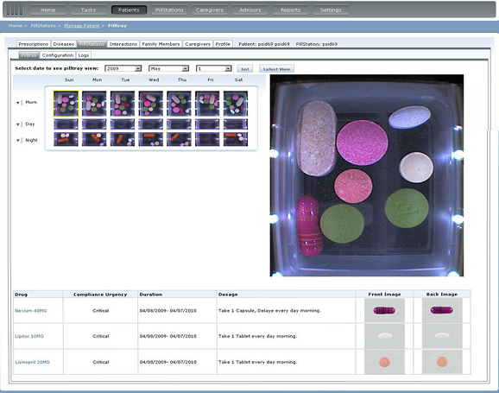
Verify Patient’s Medication
From the Portal

Slide 12
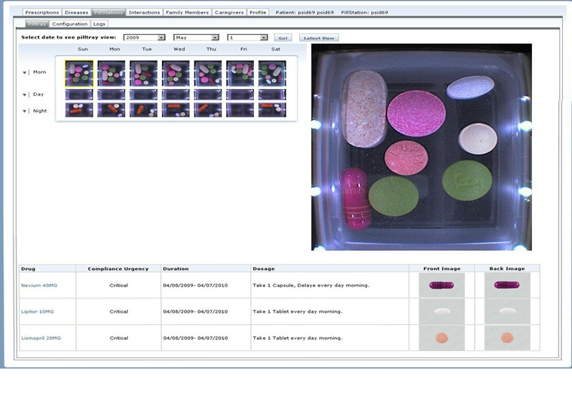
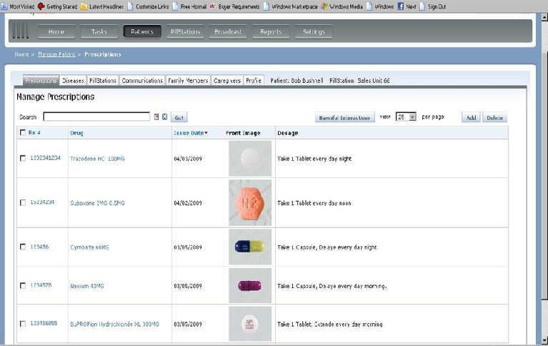
ADHT provides Medication Monitoring
Y
Y
Y
Real Time Data
Server
Y
Patient/Caregiver is engaged in a discussion if:
Medication tray is filled incorrectly
Medication is taken incorrectly
Missed alerts
Harmful Interactions and Duplications
Discussion re: nutritional guidelines and exercise
Improved Outcomes and Compliance:
Peace of mind, feeling of being cared for
Multi-Disciplinary involvement
Consistent message for improved care
Aging in Place
Y
Patient is contacted

Slide 13
Reminders and Correct Slot
Backlit for Ease of Use
Slide 13

Slide 14
The Studies
Medication Studies:
Available data indicate that approximately 30% to 50% of hospital readmissions for CHF, particularly those that occur within 90 days of initial discharge, are preventable. Successful management of chronic heart failure often includes long-term lifestyle adjustments by patients and patients’ families. Lifestyle adjustments focus on modifications in diet and activities, the need to monitor signs and symptoms, and adherence to a complex medication regimen.
From: Outpatient Costs of Medications for Patients with Chronic Heart Failure, Leslie C. Hussey, Sonya Hardin and Christopher Blanchette, Am J Crit Care 2002;11:474-478

Slide 15
Good news stories
90+ year old male patient with CHF monitoring:
Blood Pressure, Weight, Blood Oxygen, Medication
Thus far 120+ days straight without an ER visit or a hospitalization
Previous to being monitored would visit ER or be hospitalized every 7 to 14 days
Loves solution and the ADHT call center staff - RN stated “you would never be able to take the Telehealth Solutions away from him” Family feels so much stress is taken away
Developmentally delayed individual:
medication compliance issues, cannot read
medication is monitored with teleview medication unit
numerous interventions to prevent medication non-compliance and potentially serious or life threatening issues

Slide 16
Our Total Telehealth Solution
Optional Services
Over all Reporting
Equipment Set-up
Technology Platform
Quality Control
Business Management
Employee Training
Medical Device Selection
Patient Training
Inventory Control
Infection Control
Physician Liaison
Call Center
Individual Reports

Slide 17
Thank you for your time
Contact Information
Betty Couture
Call: 716-218-7169
Email: betty@advtelehealth.com
Slide 17
Slide 17

